Slide 1


Slide 2
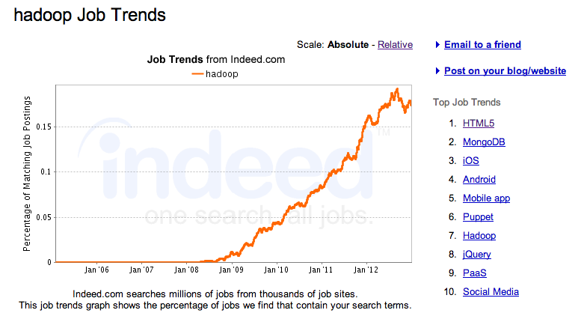

Slide 3
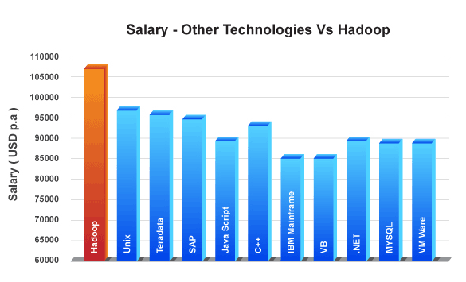
Salary for Hadoop

Slide 4
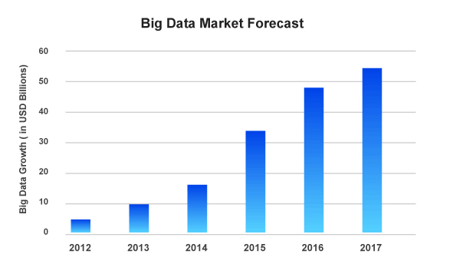
Big Data Market Growth

Slide 5
HADOOP

Slide 6
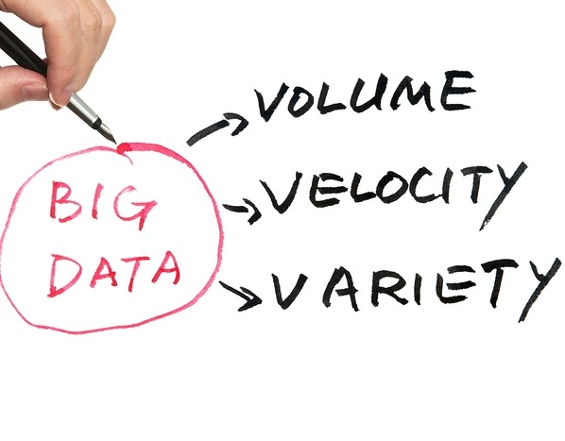
Big Data
What is Big Data?
Big data can be characterized by 3Vs:
The extreme volume of data.
The velocity at which the data must be must processed.
The wide variety of types of data.
Volume: Size, Amount or Quantity of Data.
Velocity: Speed of data.
Speed at which data must be stored.
Speed at which data must be processed.
Variety: Type of data to be stored or processed.
Structured Data
Unstructured Data
Semi-Structured Data

Slide 7
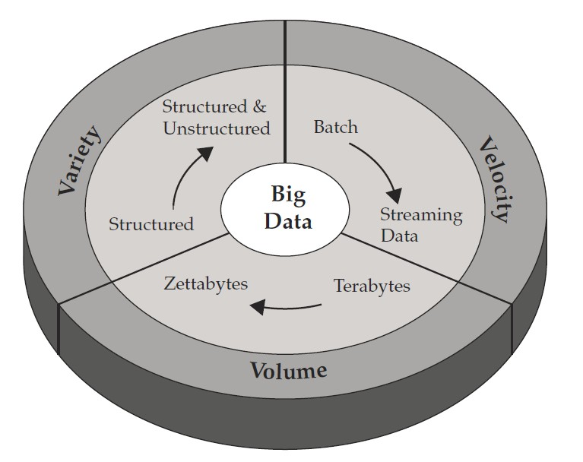
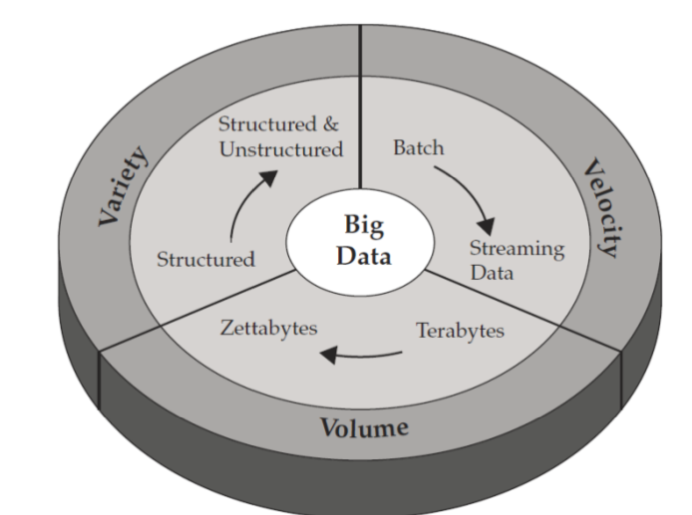
Big Data
Characterization of Big – Data
Volume , Velocity , Variety (V3)

Slide 8
What Is Hadoop?
We need a system that should support :-
Distributed Parallel processing
Built in backup and fail-over mechanism
Easily scalable and Economical
Efficient and Reliable
So We Need Hadoop
A framework for storing & processing of data using commodity hardware and storage

Slide 9
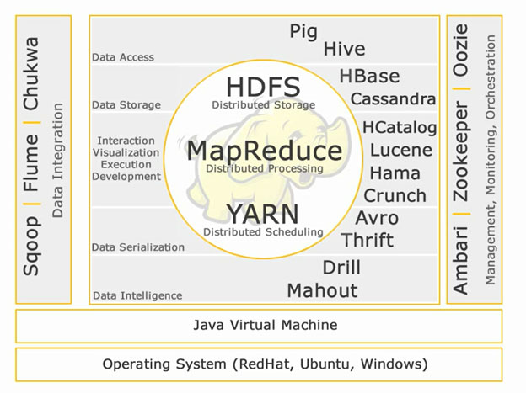
Overview to Hadoop system
Hadoop EcoSystem Components

Slide 10
The Hadoop Distributed File System, or HDFS.
HDFS is the storage system for a Hadoop
When data arrives at the cluster, the HDFS software breaks it into pieces and distributes those pieces among the different servers participating in the cluster
Each server stores just a small fragment of the complete data set
each piece of data is replicated on more than one serve

Slide 11
Hadoop Cluster Modes
Different modes of hadoop:-
●
Standalone Mode
Pseudo Distributed Mode(Single Node Cluster) Fully distributed mode (or multiple node cluster)
●
●
Standalone Mode
Default mode of Hadoop
HDFS is not utilized in this mode.
Local file system is used for input and output .
No Custom Configuration is required in 3 hadoop files
mapred-site.xml
core- site.xml
hdfs-site.xml
Standalone mode is much faster than Pseudo-distributed mode.

Slide 12
Hadoop Cluster Modes
Pseudo Distributed Mode(Single Node Cluster)
Configuration is required in given 3 files for this mode Replication factory is one for HDFS.
Here one node will be used as Master Node / Data Node / Job Tracker / Task Tracker
Used for Real Code to test in HDFS.
Pseudo distributed cluster is a cluster where all daemons are Running on one node itself.
Fully distributed mode (or multiple node cluster)
This is a Production Phase
Data are used and distributed across many nodes.
Different Nodes will be used as Master Node / Data Node / Job Tracker / Task Tracker

Slide 13
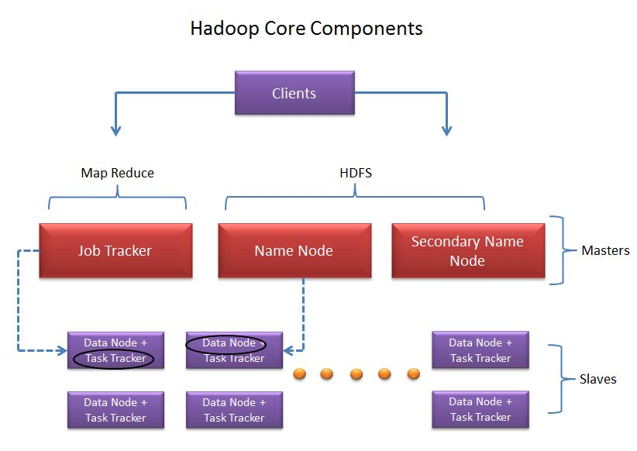
Hadoop Cluster – Core Components
Core Components of Hadoop Cluster:-
Hadoop cluster has 3 components:
Client.
Master.
Slave.
The role of each components are shown in the below image.

Slide 14
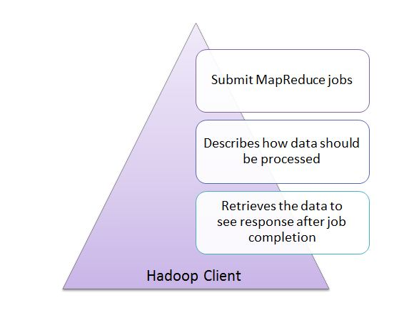
Hadoop Cluster – Core Components
Client:-
It is neither master nor slave, rather play a role of loading the data into cluster, submit MapReduce jobs describing how the data should be processed and then retrieve the data to see the response after job completion.

Slide 15
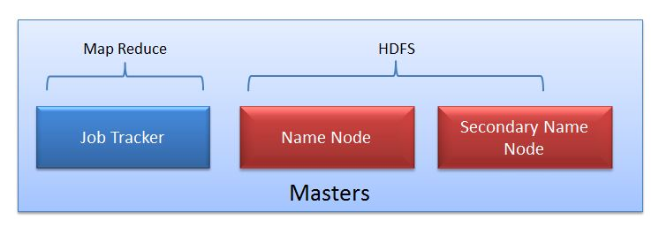
Hadoop Cluster – Core Components
Masters:-
The Masters consists of 3 components
NameNode
Secondary Namenode
JobTracker.

Slide 16
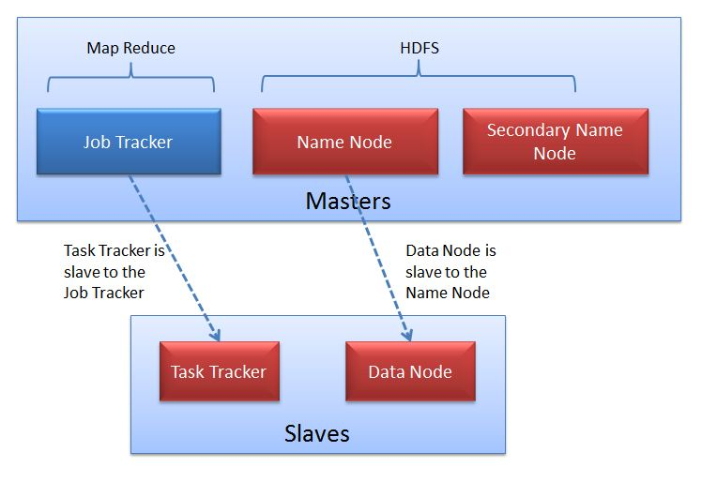
Hadoop Cluster – Core Components
Slaves:-
Slave nodes are the majority of machines in Hadoop Cluster and are responsible to
Store the data
Process the computation
Each slave runs both a DataNode and Task Tracker daemon which communicates to their masters. The Task Tracker daemon is a slave to the JobTracker and the DataNode daemon a slave to the NameNode.

Slide 17
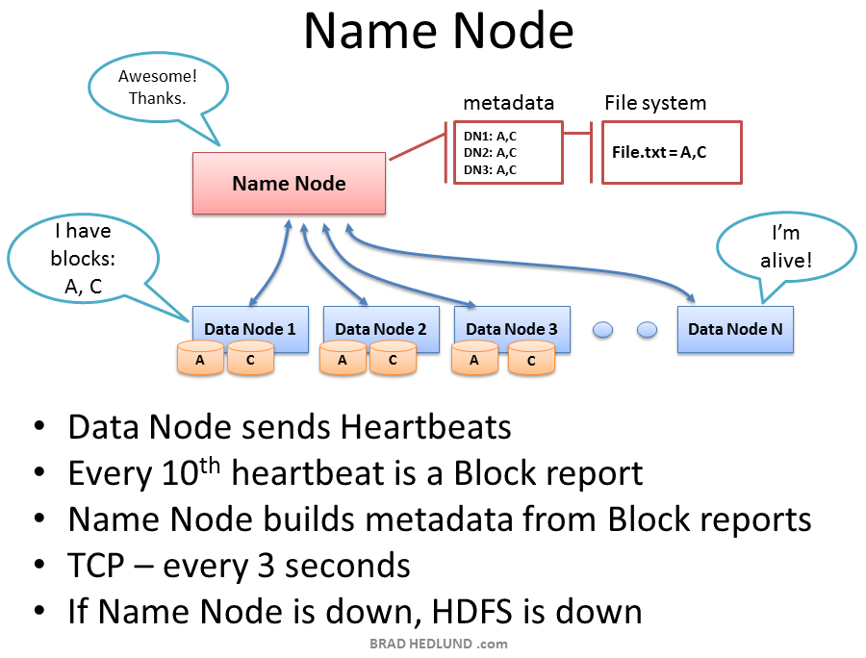
dfs.replication parameter in the file hdfs-site.xml.
Equip the Name Node with a highly redundant enterprise class server configuration; dual power supplies, hot swappable fans, redundant NIC connections, etc.

Slide 18
YARN
YARN - YARN stands for Yet Another Resource Negotiator. It is also called as MapReduce 2(MRv2). The two major functionalities of Job Tracker in MRv1, resource management and job scheduling/ monitoring are split into separate daemons which are :-
ResourceManager
NodeManager
ApplicationMaster.
Features:-
• Better resource management.
• Scalability
• Dynamic allocation of cluster resources.

Slide 19
MapReduce
Parallel Job processing framework
Written in java
Close integration with HDFS
Provides :
Auto partitioning of job into sub tasks
Auto retry on failures
Locality of task execution

Slide 20
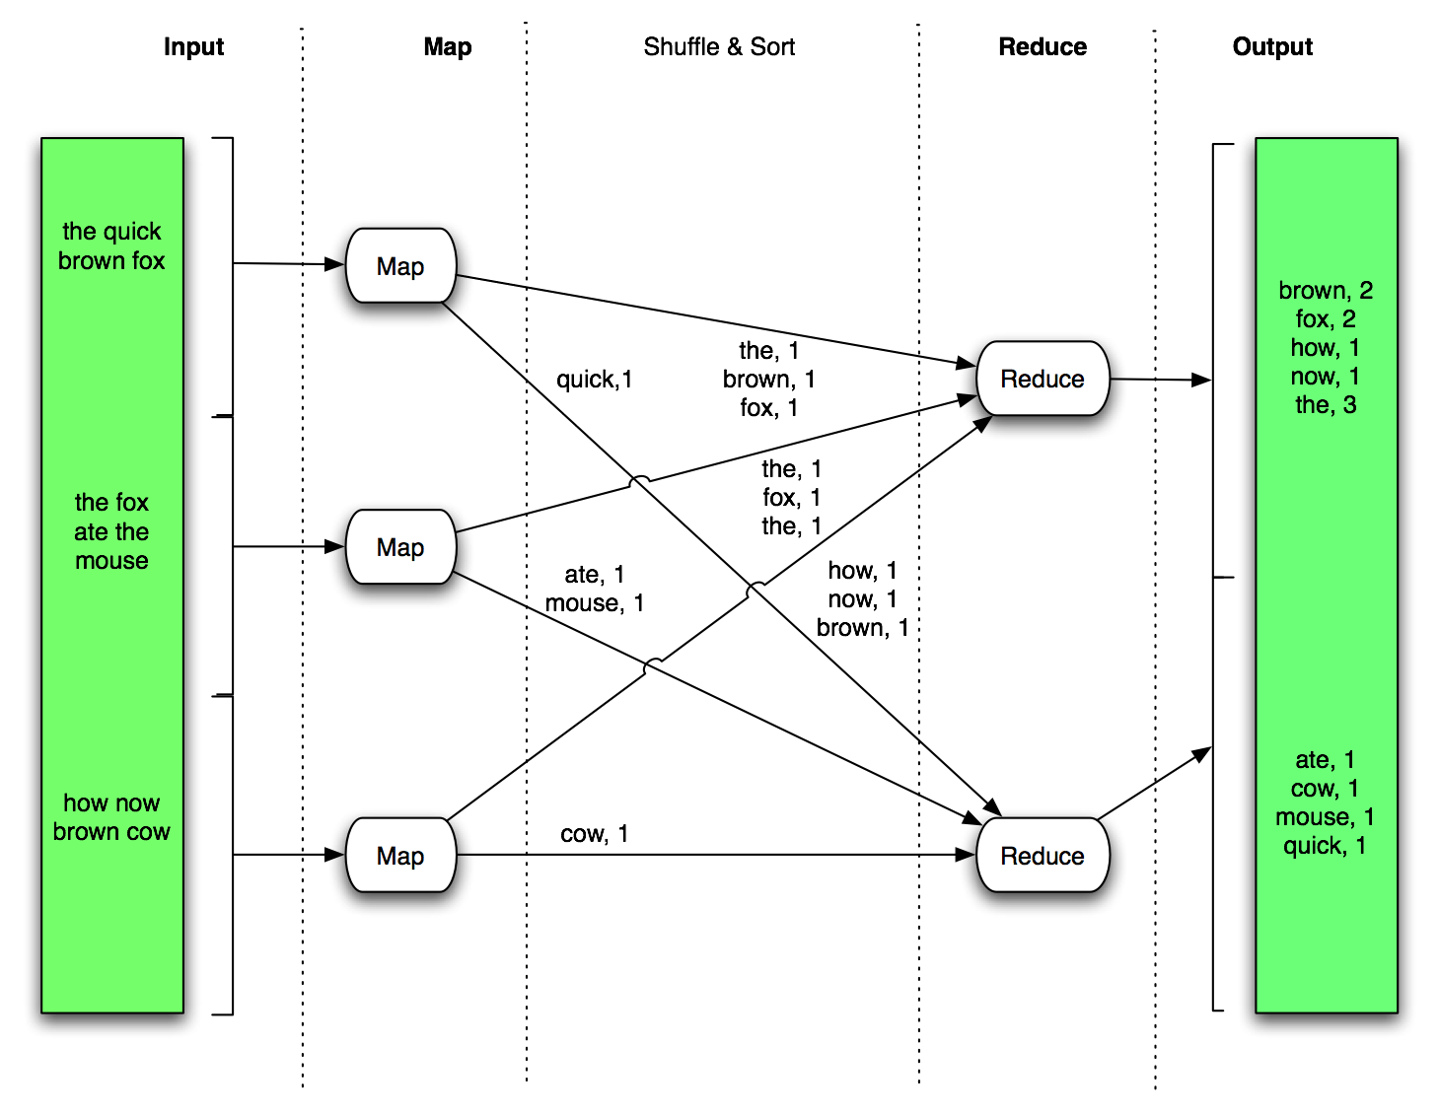
Map-Reduce Example

Slide 21

Hive
Apache Hive in a few words:
“A data warehouse infrastructure built on top of Apache Hadoop”
Used for:
Ad-hoc querying and analyzing large data sets without having to learn MapReduce
Main features:
SQL-like query language called HQL
Built-in user defined functions (UDFs) to manipulate dates, strings, and other data-mining tools
Support for different storage types such as plain text, HBase, and others

Slide 22

PIG
Data Access:
Pig -Apache Pig is an abstraction over MapReduce. It is a tool/platform which is used to analyze larger sets of data representing them as data flows. Pig is generally used with Hadoop; we can perform all the data manipulation operations in Hadoop using Apache Pig.
To write data analysis programs, Pig provides a high-level language known as Pig Latin. This language provides various operators using which programmers can develop their own functions for reading, writing, and processing data.
To analyze data using Apache Pig, programmers need to write scripts using Pig Latin language. All these scripts are internally converted to Map and Reduce tasks. Apache Pig has a component known as Pig Engine that accepts the Pig Latin scripts as input and converts those scripts into MapReduce jobs.
Salient features of pig:
• Ease of programming
• Optimization opportunities
• Extensibility.
Note :- Pig scripts internally will be converted to map reduce programs.

Slide 23

Zookeeper
"ZooKeeper allows distributed processes to coordinate with each other through a shared hierarchical name space of data registers"
Configuration management - machines
config from a centralized source,
facilitates simpler deployment/provisioning
Leader election - a common problem in distributed coordination
Centralized and highly reliable (simple) data registry

Slide 24

FLUME
Apache Flume - Flume is a distributed, reliable, and available service for efficiently collecting, aggregating, and moving large amounts of log data.
Features:
• Robust
• Fault tolerant
• Simple and flexible Architecture based on streaming data flows.

Slide 25
Sqoop
Sqoop is a tool designed to transfer data between Hadoop and relational databases. You can use Sqoop to import data from a relational database management system (RDBMS) such as MySQL or Oracle into the Hadoop Distributed File System (HDFS), transform the data in Hadoop MapReduce, and then export the data back into an RDBMS.Four key features are found in Sqoop:
Bulk import: Sqoop can import individual tables or entire databases into HDFS. The data is stored in the native directories and files in the HDFS file system.
Data export: Sqoop can export data directly from HDFS into a relational database using a target table definition based on the specifics of the target database

Slide 26
Any Questions?

